Slide 1

Data driven strategy with ELK
Notes:
-Have you ever been tired of:
doing a lot of steps to read logs?
open lots of log files and sometimes you cannot remember where are they?
-You are not developer and found the logs are hard to understand?
-You want to make a big change in your company system and your boss need to know the current situation of system. They are in system logs but how to present it in a straightforward and more impressive way to you boss?
-All of them will be resolve with our topic today.. How about if we have one place to read all of your logs and moreover, you can find an event in your all logs in nearly a seconds?
-Let come to ELK stack, one solution can resolve all of your log problem
-What ELK stack could bring to us?
We can monitor production, resource usage
Performance analyze
Tracking client request, keytrend
We can see log immediately, reduce the risk of lost log files
Non-developer could understand situation of sytem
Find event faster, easier.
-So, what is ELK, how to make it work?
ELK is short of Elasticsearch - logstash - kibana.
Logstash..
Elasticsearch..
Kibana…
And last but not least, how to apply for it?
- Know your log structure
- Parse log
- Visualize

Slide 2
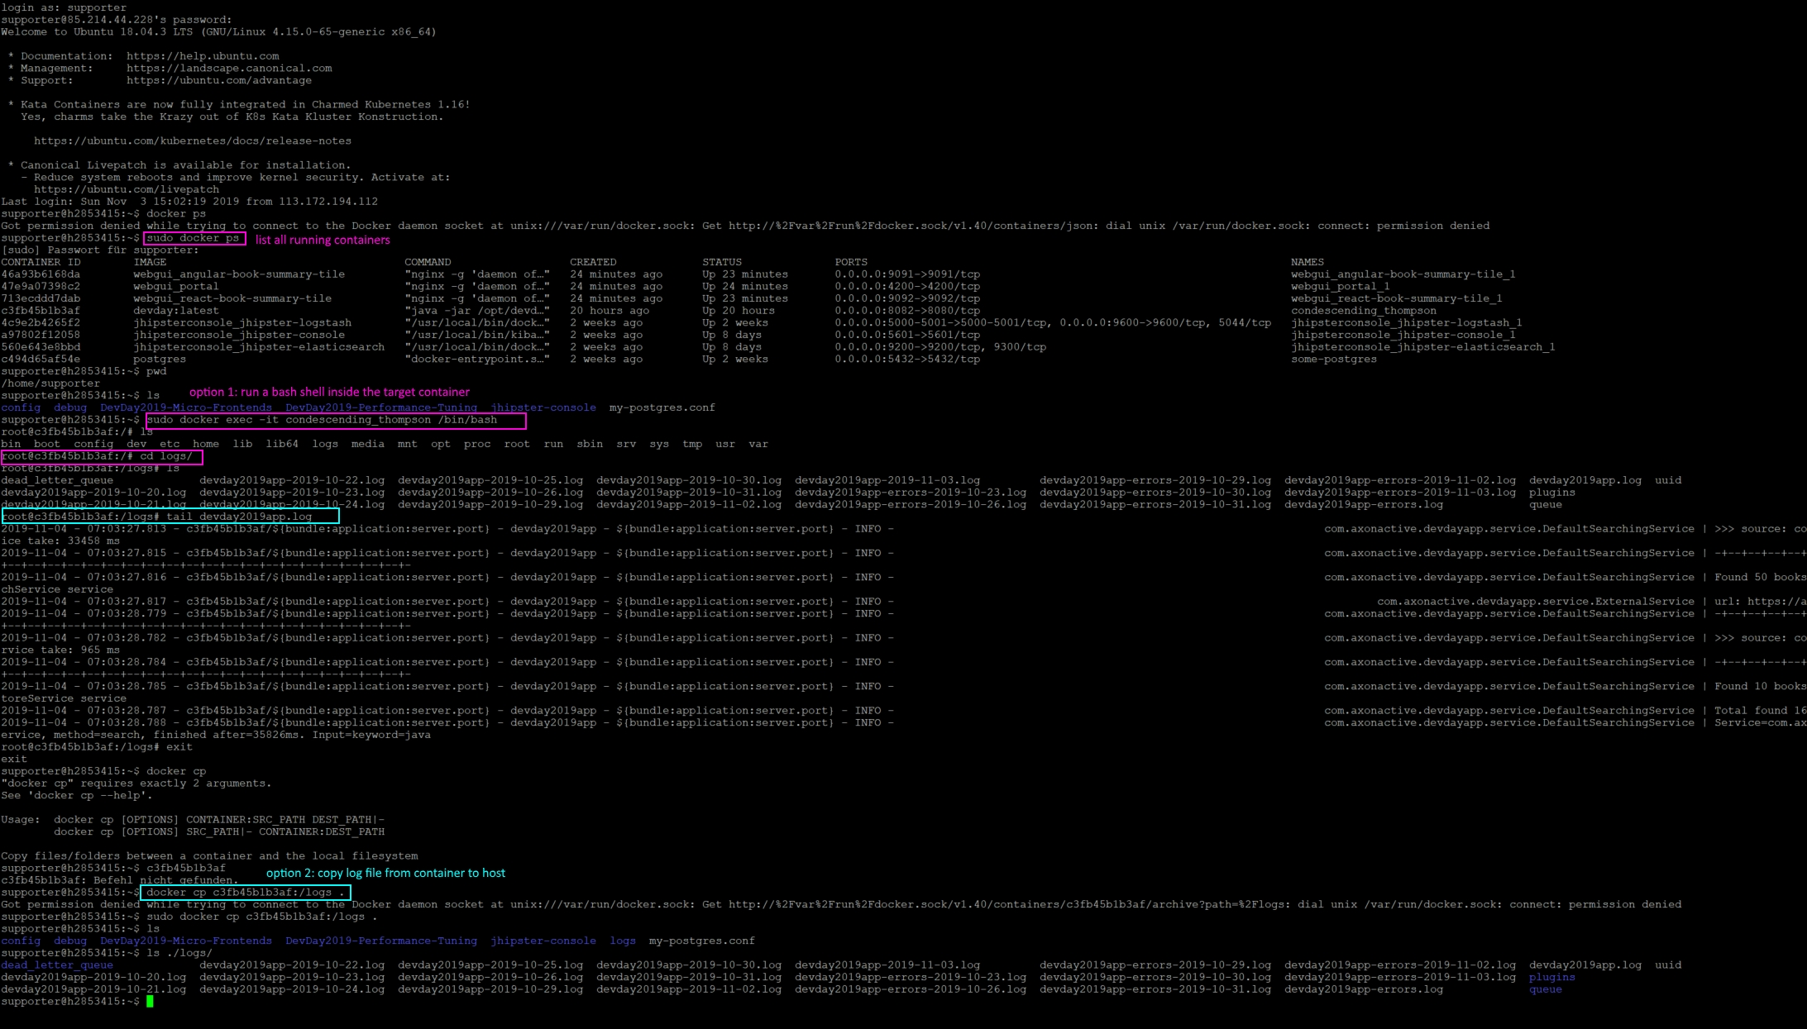
lots of steps when reading log !!!

Slide 3
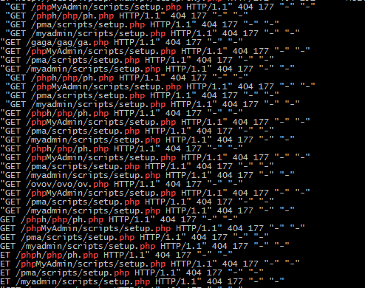

where is my log?

Slide 4
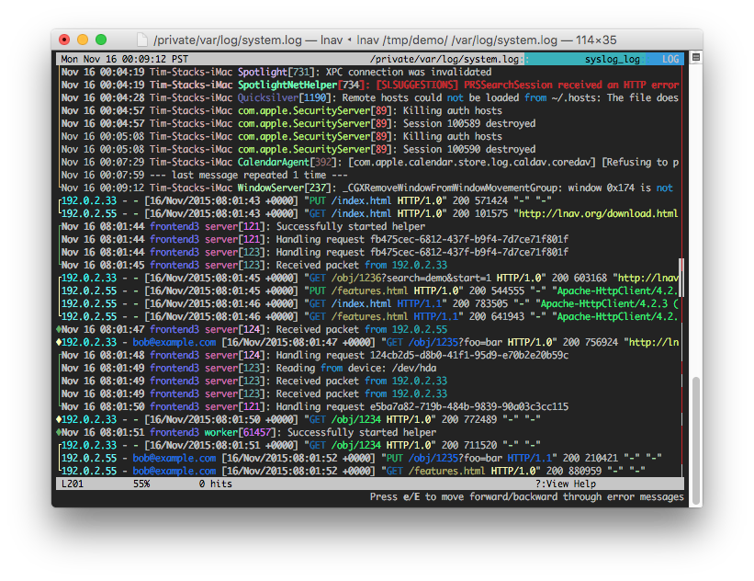

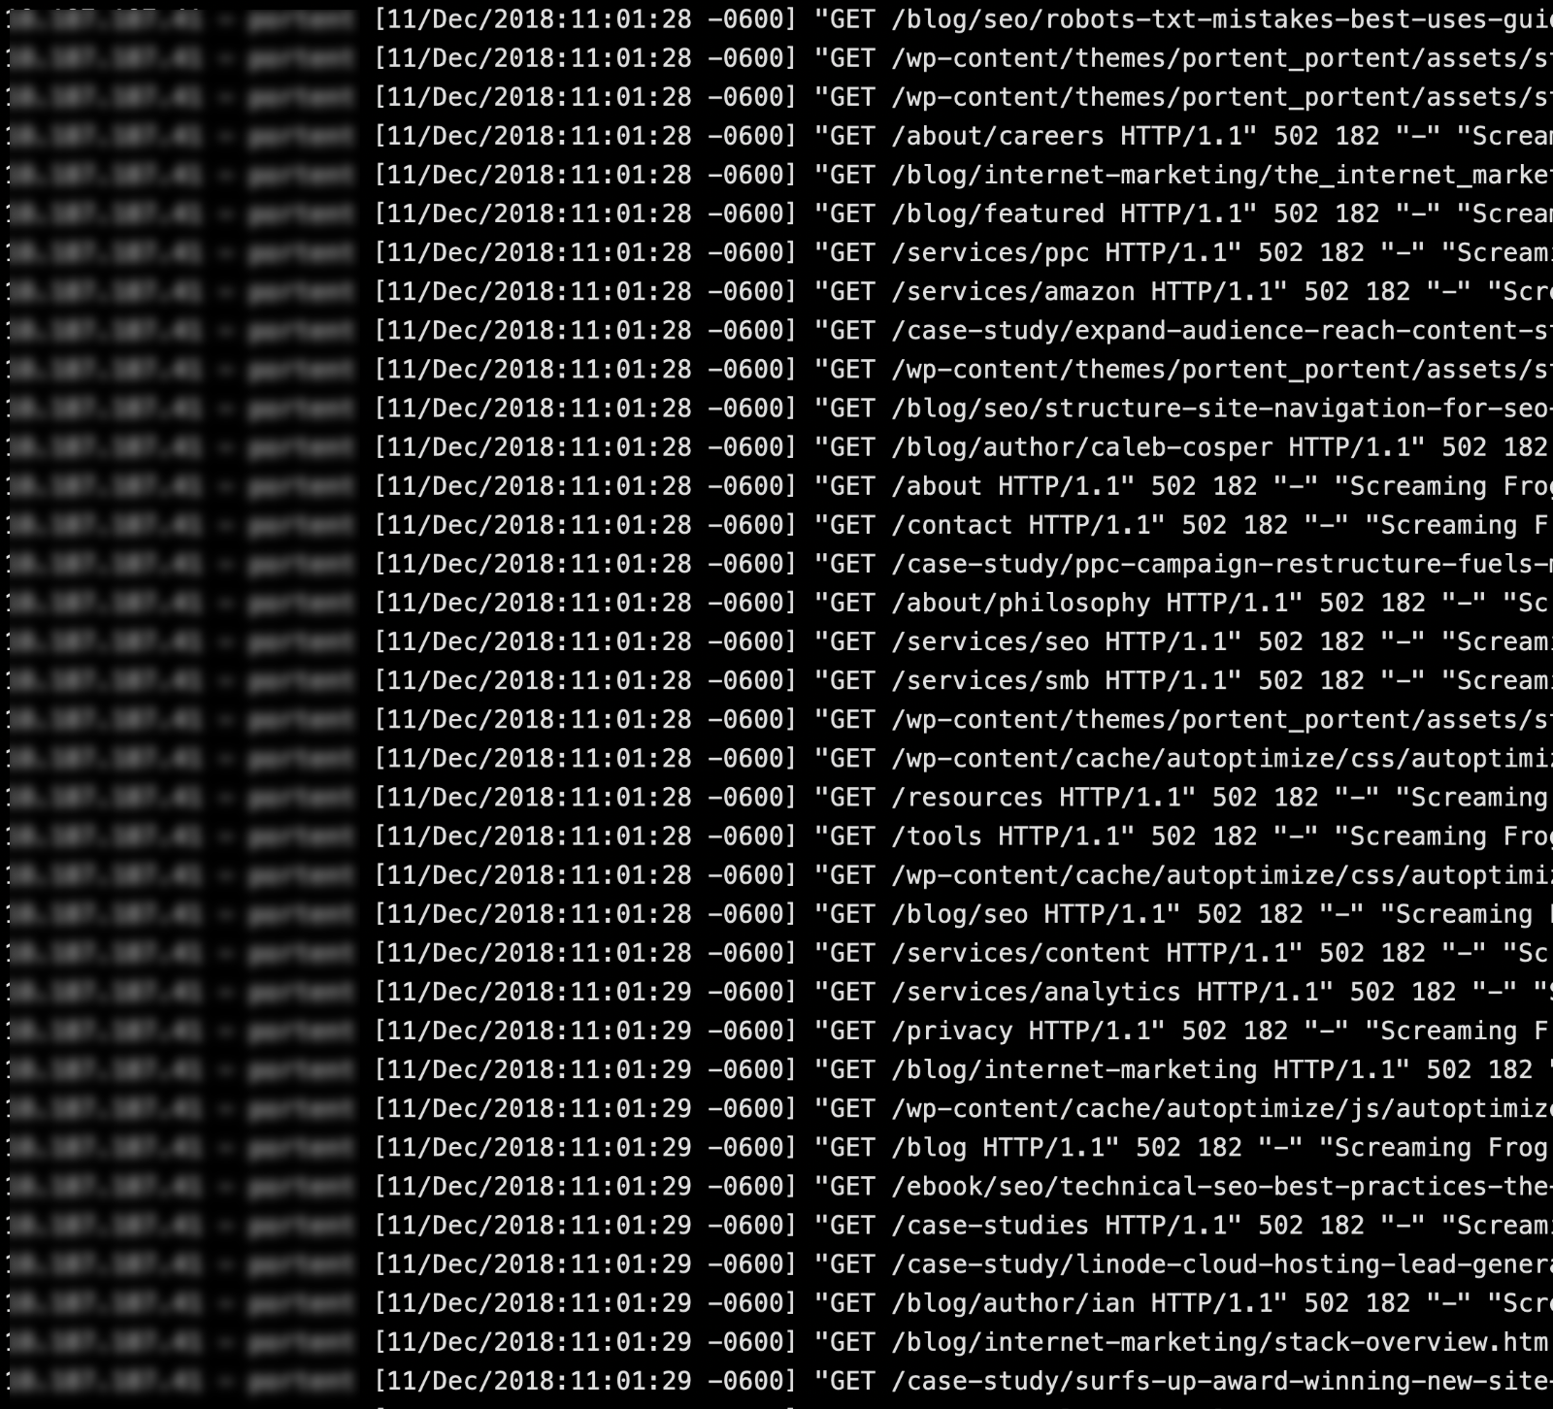

Slide 5

server response time?
product's customer usage?
most called service?
resource usage?

Slide 6
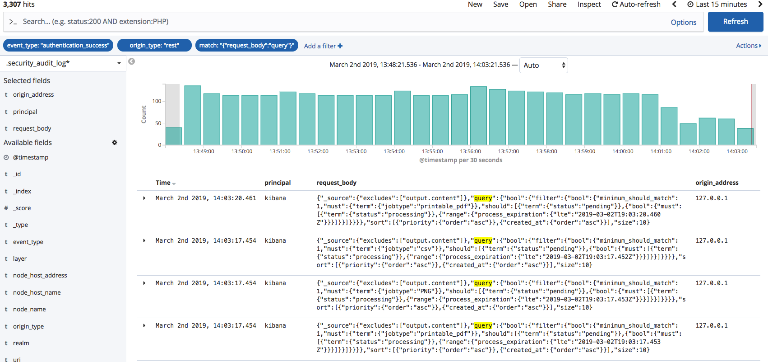

How about?

Slide 7
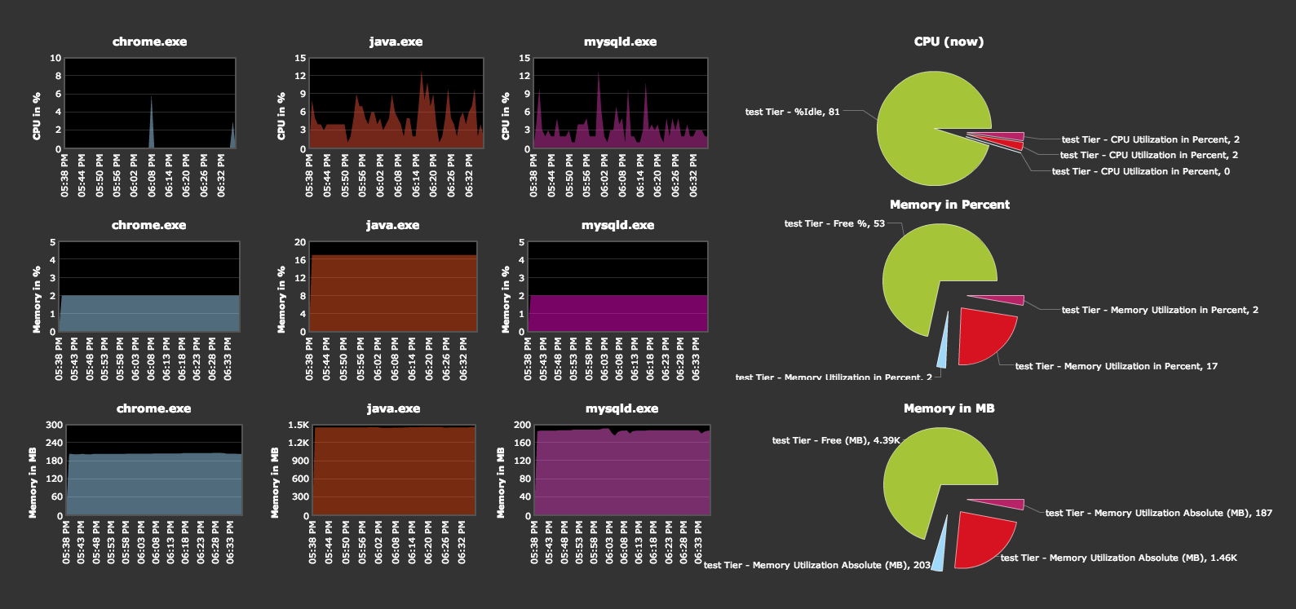
Benefits
Production monitoring and debugging
Resource usage

Slide 8
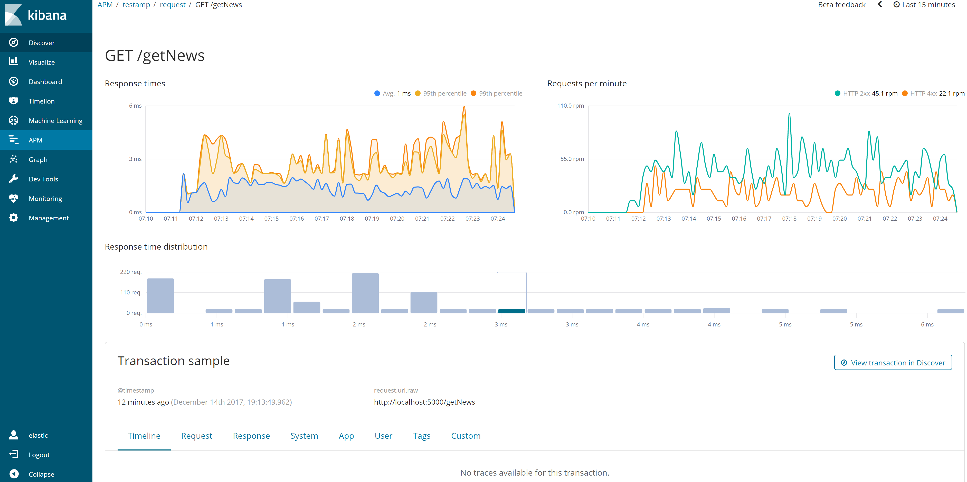
Benefits
Performance analysis

Slide 9
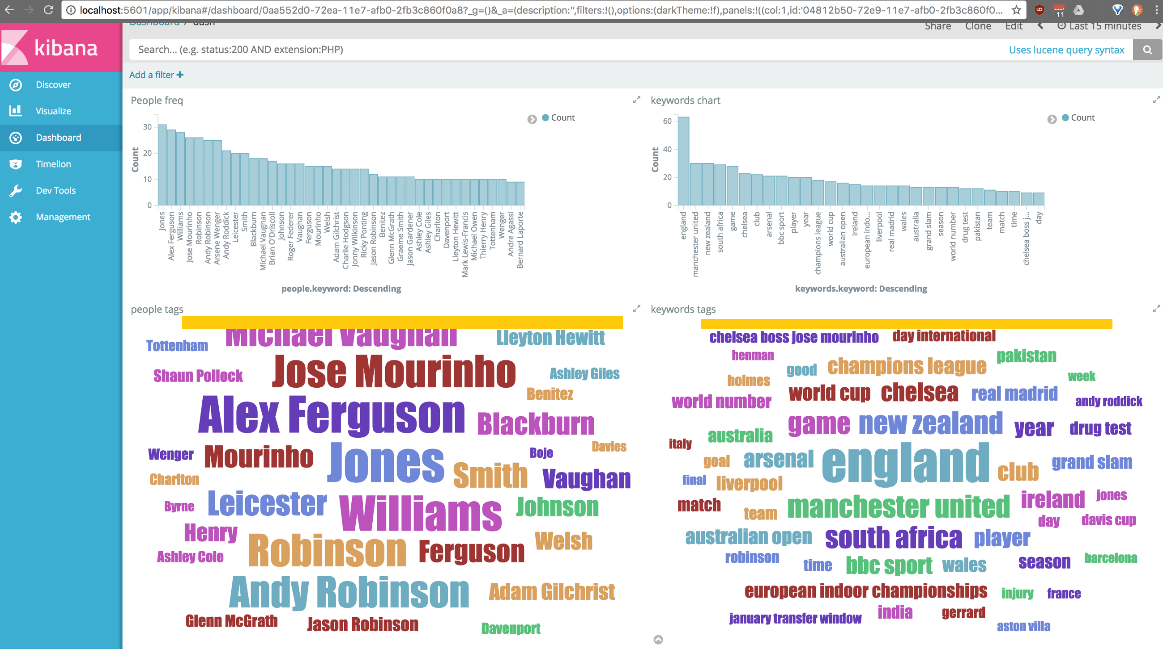
Benefits
Tracking client requests
Identifying key trends

Slide 10

Benefits
Live logging

Slide 11
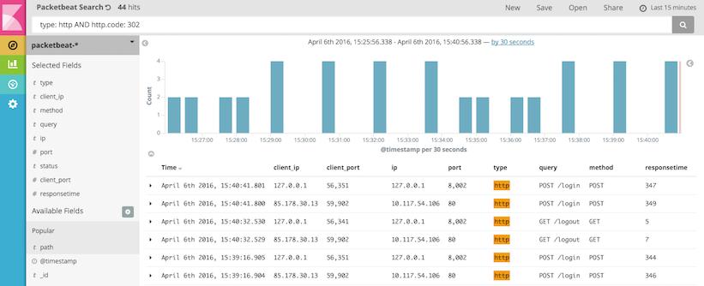
Benefits
Easy to read even if you're not developers
Easily and quickly to find information

Slide 12
Work-flow

Slide 13

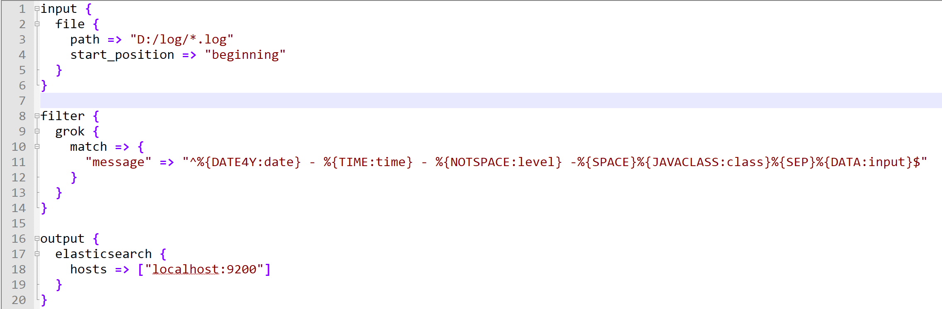
Logstash
Parse log line into the readable format

Slide 14
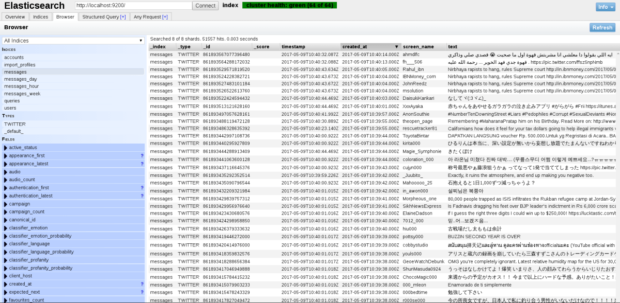
Elasticsearch
Store logs
Act as a data source for Kibana

Slide 15
Kibana
Display information using charts

Slide 16
Getting started
1. Know your log structure
2. Parse log by Logstash
3. Visualize by Kibana

